Slide 1

CVSL Coach Information for Fall 2024

Slide 2
Area 6B Director
Ashley Troutman
Traveling Teams/Tournaments
Area Volunteers
Board Expectations
100% Volunteer - Board Members, Coordinators, Including Myself

Slide 3
Region 803 Board Members
Region 803 Coordinators
Regional Commissioner: Josh Odegard
Coach Administrator: Brian Kjesbo
CVPA: Holly Thomas
CVPA: Kylie Godfrey
Referee Administrator: Joseph Ripienski
Safety Director: Jessica Pederson
Treasurer: Courtney Ricci
Equipment: Joseph Baiocco
Scheduler: Jessica Pederson

Slide 4
Help Wanted!!
We are always looking for more help!
Positions needed are Concession Coordinators, Registrars, Uniform Coordinators and many more!
Please visit https://aysovolunteers.org/volunteer-positions/ for a full list of positions.

Slide 5
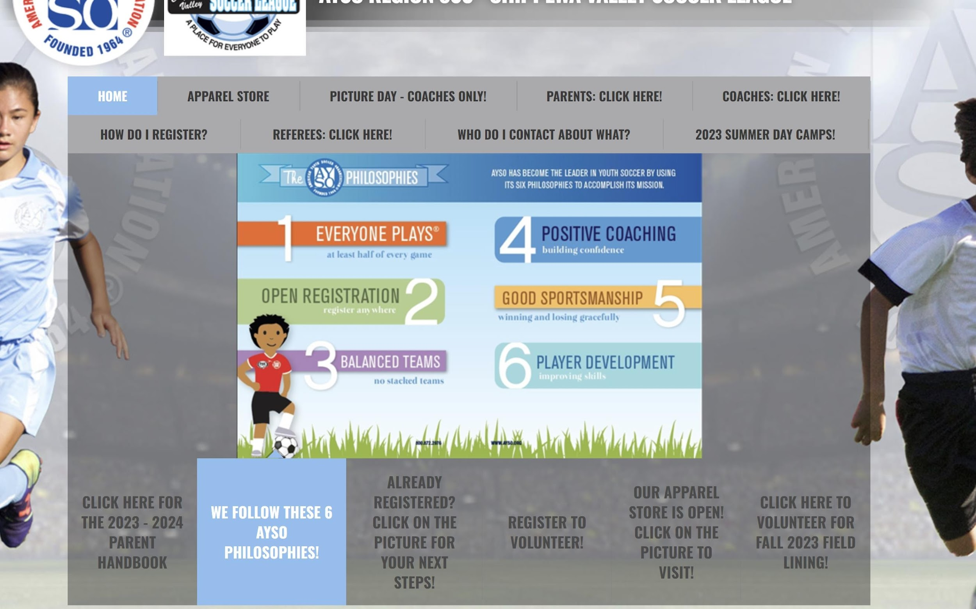

Coaches Page on Website

Slide 6
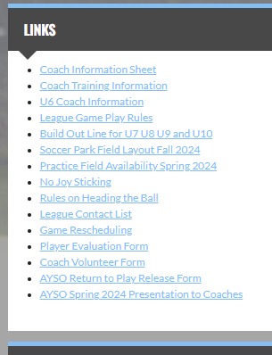
Coach Information on Website

Slide 7
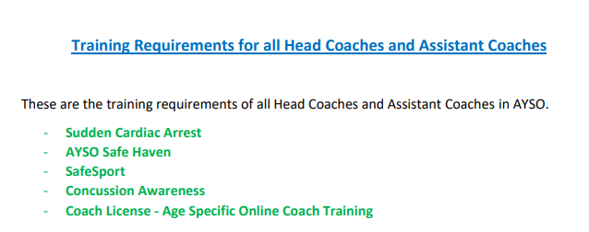

Slide 8

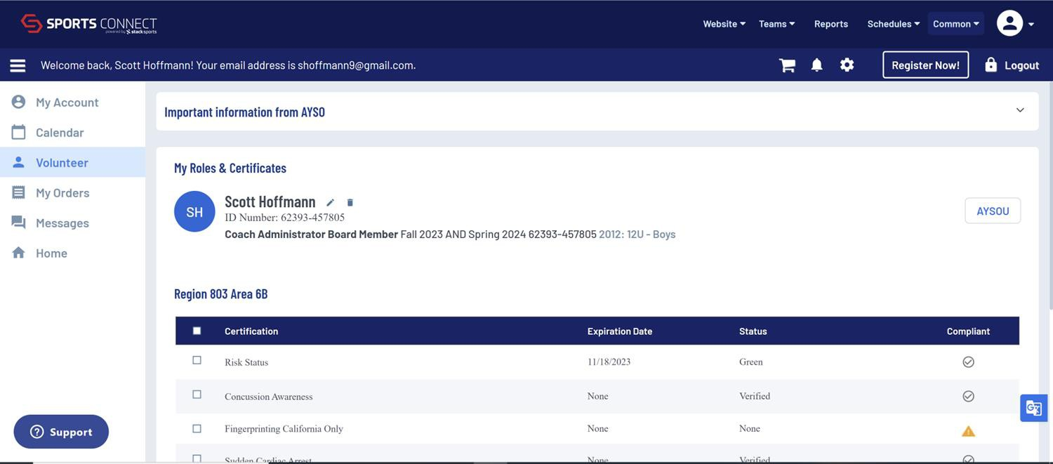
How to Verify Training Completed

Slide 9

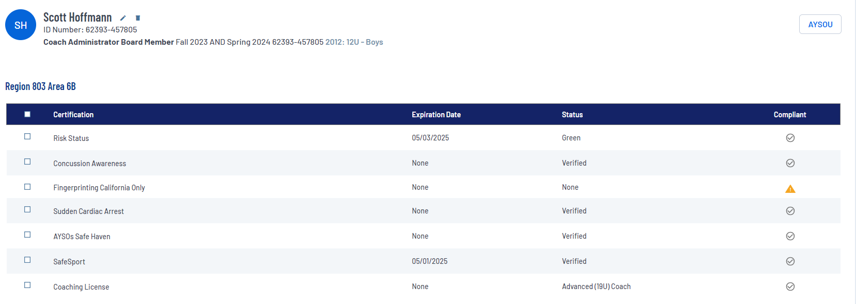

Slide 10



Path to AYSOU for Training and Certification Verifications

Slide 11

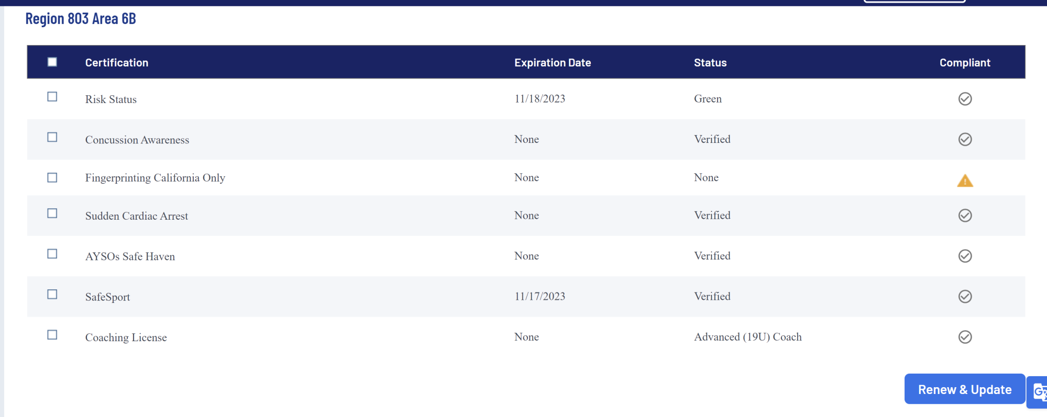
Risk Status Must Be Green

Slide 12
Coach Training by P2 on Sunday September 8
“What should I do?” at practice is a common concern of coaches. We have
hired P2 Soccer Training instructors to facilitate age specific training for
coaches on practice sessions.
Loca#on:
Gymnasium at Robbins Elementary School, 3832 E Hamilton Ave, Eau Claire
September 8 Schedule:
Noon – 1:00 pm U6 Coaches
1:00 pm – 2:00 pm U7/U8 Coaches
2:00 pm – 3:15 pm U9/U10 Coaches
3:15 pm – 4:30 pm U11/U12 Coaches
4:30 pm – 5:30 pm U14/U19 Coaches

Slide 13
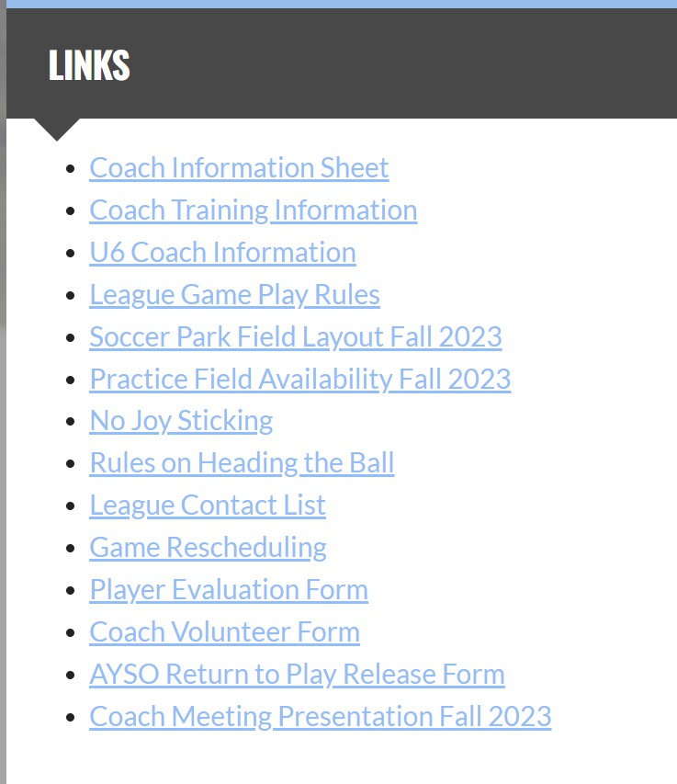

Practice Field
Information
on Website

Slide 14
Practice Fields
City owned areas are free to use. First-come first-serve basis. Cannot reserve.
Eau Claire Area School District sites are reserved by our league for your use. First-come first–serve basis for teams. Teams cannot reserve.

Slide 15
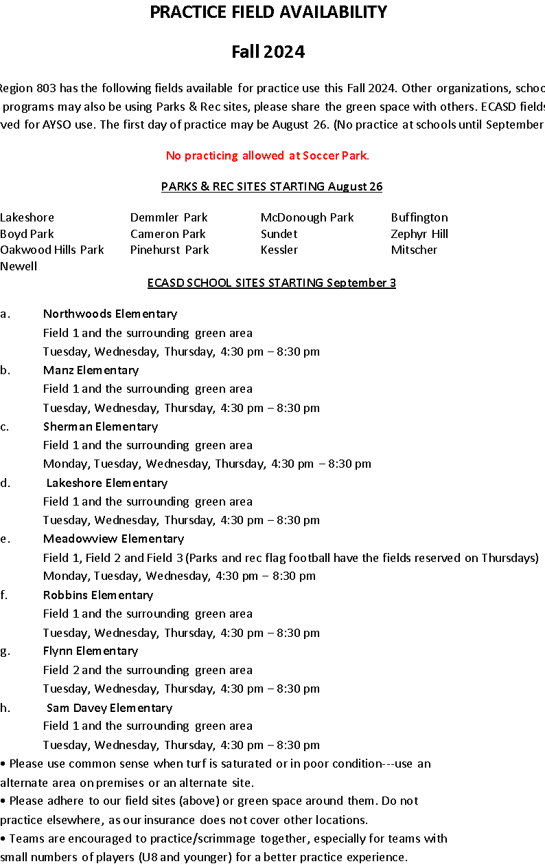

Slide 16
Google Doc for Practices
  Feedback

Slide 17
Coach Information on Website

Slide 18
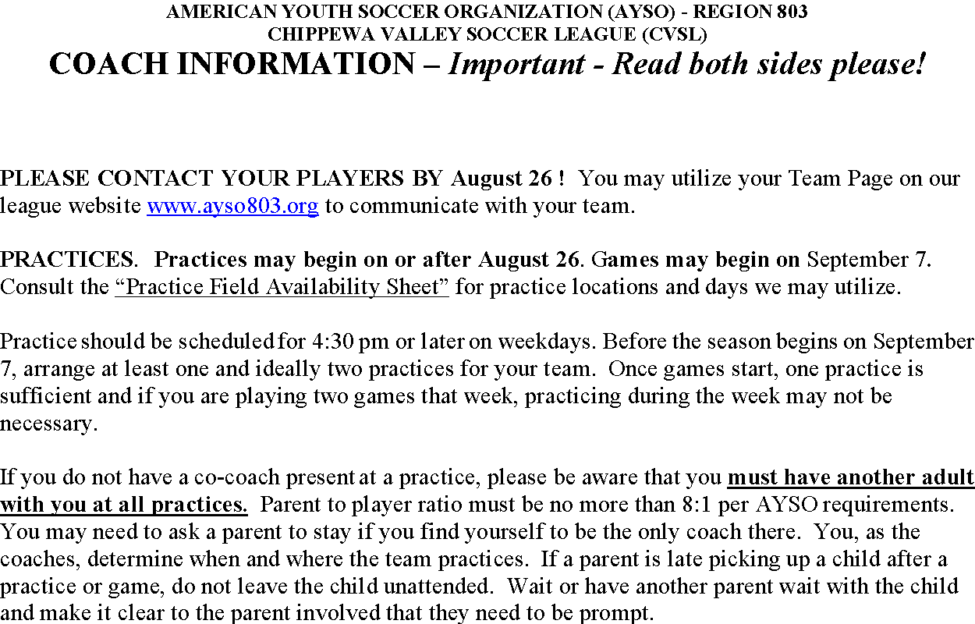

Slide 19


American Youth Soccer Organization

Slide 20

Players Must Be Registered
May not recruit non-AYSO registered players for games
May not include non-AYSO registered players for practices
American Youth Soccer Organization

Slide 21
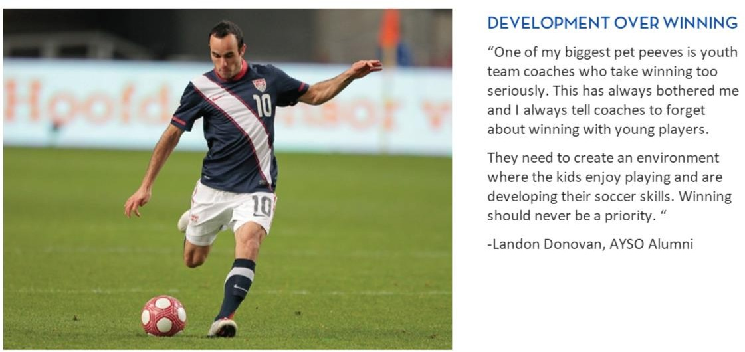
We Don’t Keep Score

Slide 22
Set Expectation Level
Remind parents that CVSL is a league of over 900 kids, 90+ teams – run by all volunteers. A huge undertaking every year. Expectation levels should be set accordingly.
Relax – Be Kind – Have Fun!
American Youth Soccer Organization

Slide 23
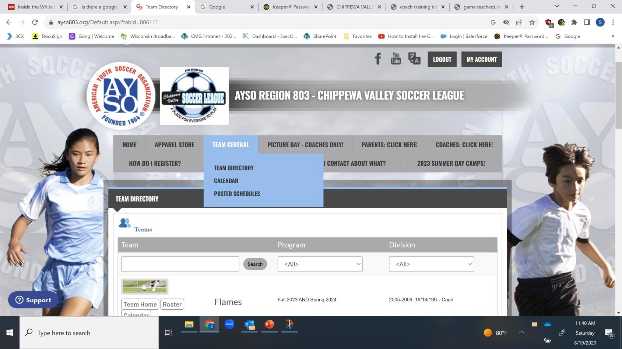
Team Pages

Slide 24

Rules – Key Points
Ball in and out of play
  U6/U7 try to limit stoppage
  Throw in technique not as important
Coaches on the field only at U6
Substitution Rule – free substitution, but strongly encourage substitutions at quarter breaks
American Youth Soccer Organization

Slide 25
Rules – Key Points
No Goal Keepers U6, U7, U8
Parents at opposite side of field
No Offside Rule enforced until U11/12
No Slide Tackling U10 and younger – safety
Be Respectful to Referees
American Youth Soccer Organization

Slide 26
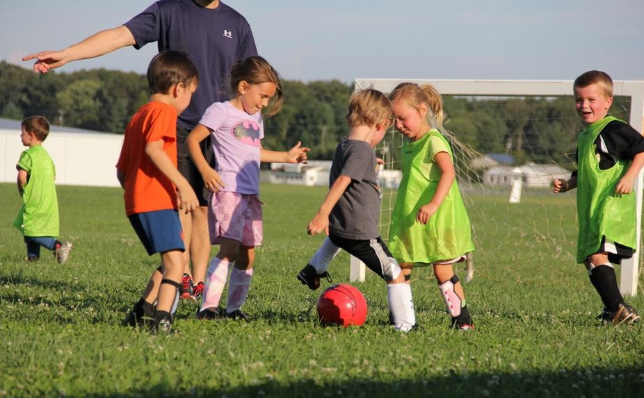
Game Time Begins With Good Sportsmanship

Slide 27
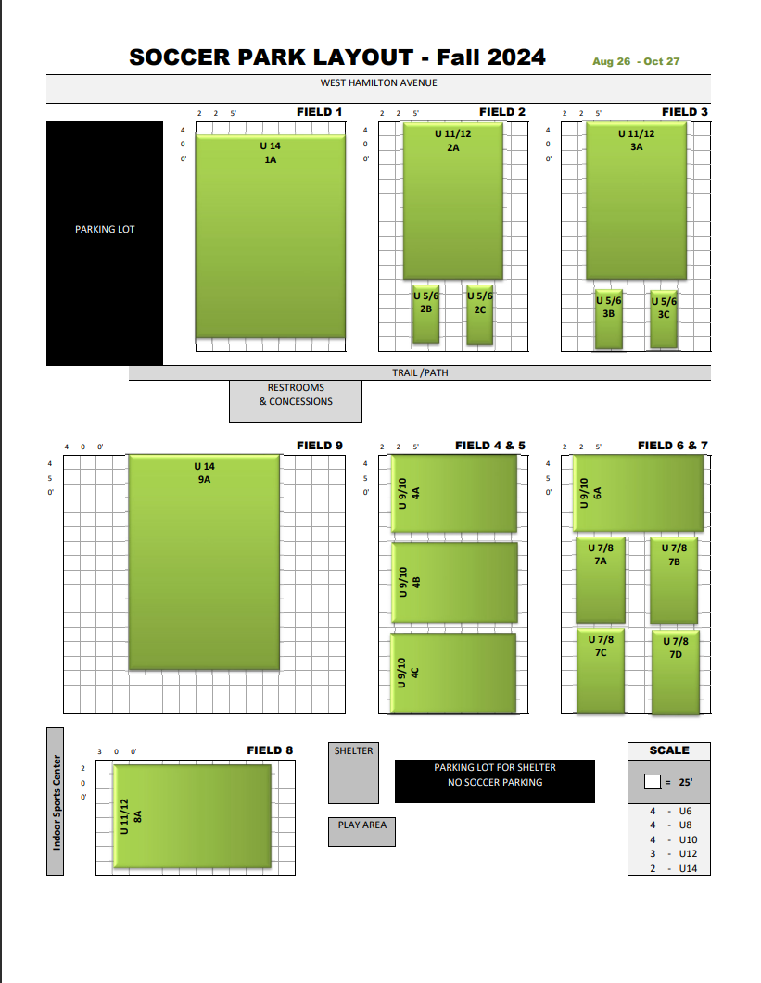

Slide 28
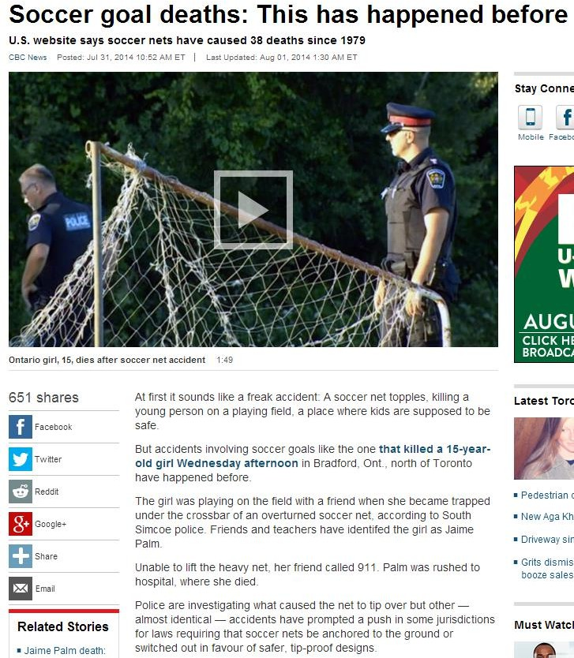
Check Anchoring of Goals Before Games
If you find goal is not properly anchored, contact me and do not play your game.
American Youth Soccer Organization

Slide 29

Start Games On Time

Slide 30
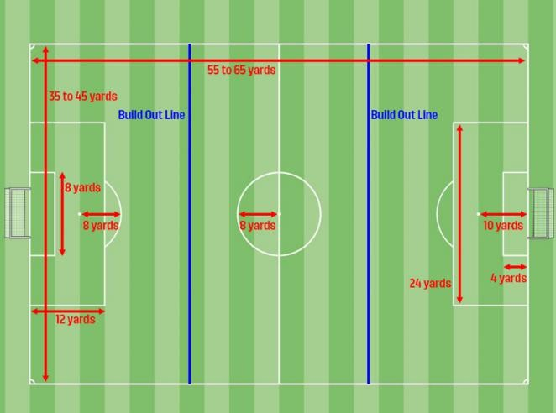
Build Out Line U9/U10

Slide 31
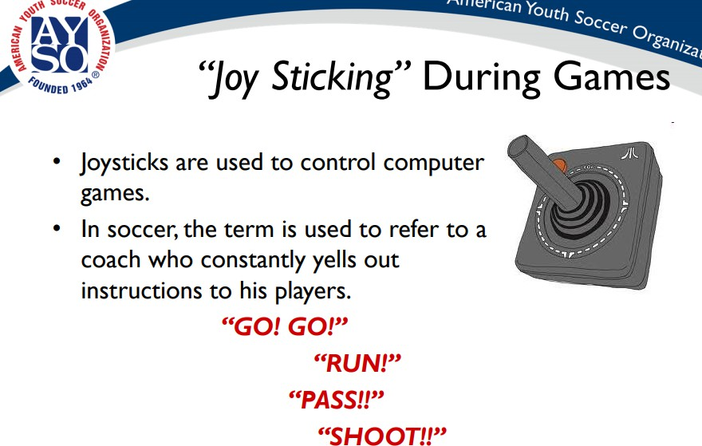

Slide 32
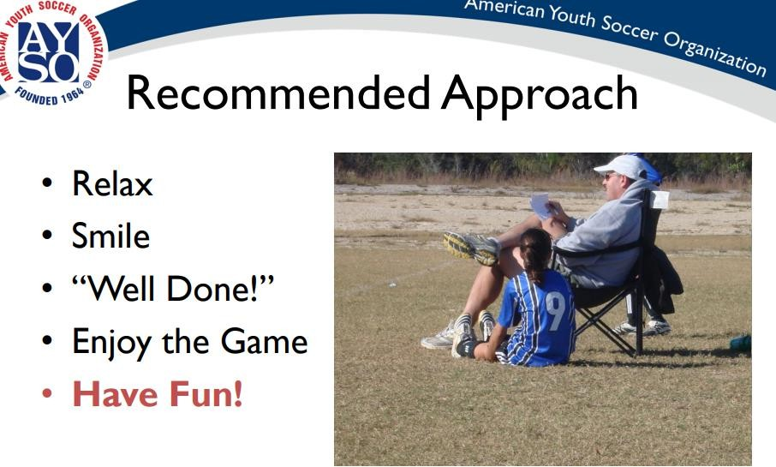

Slide 33
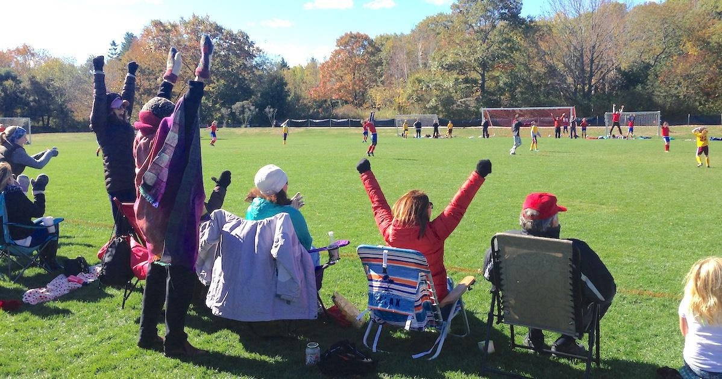
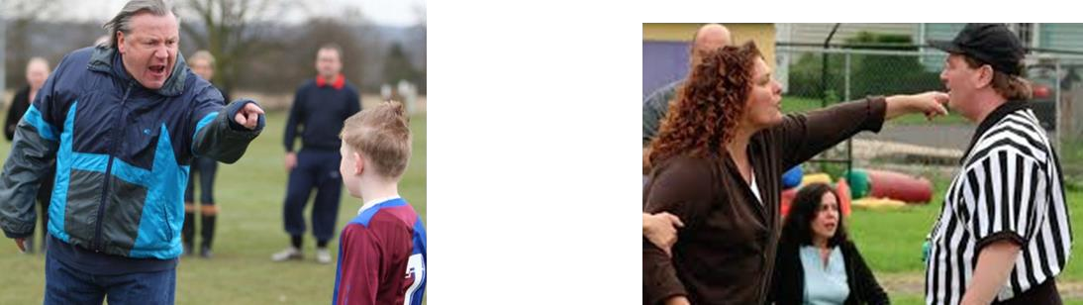

Slide 34
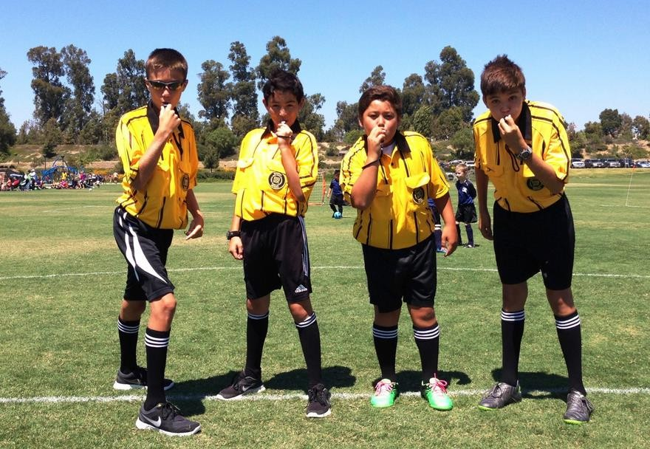
Support Our Referees

Slide 35
Referee Administrator:
Joe Ripienski referees@ayso803.org
American Youth Soccer Organization

Slide 36
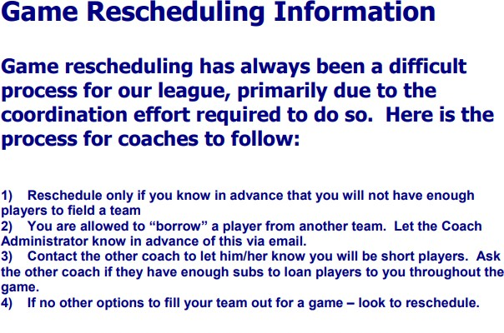
If rescheduling or cancellation is necessary, please email scheduler@ayso803.org with the below information:
Both Team Coaches and referees@ayso803.org included in the Email
Original Date & Time for Game
Requested Monday date to reschedule, if rescheduling only

Slide 37

Safety
First Aid Kits
Injuries
scheduler@ayso803.org for more information or to report an injury.
American Youth Soccer Organization

Slide 38
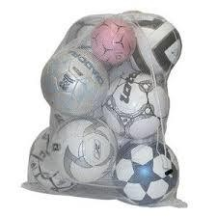
Miscellaneous Stuff
Hold your equipment after the Fall season for the Spring season.
Flags away after games.
Equipment boxes at soccer park.
Bags will have equipment tags this year to assist in tracking and return of bags.
American Youth Soccer Organization

Slide 39
Picture Day
Linhoff Photography
7:30am - 12pm
5 Photographers
September 14 and 21
Rain date September 28
American Youth Soccer Organization

Slide 40
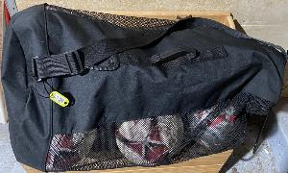
Bag checkout process
1
Locate your division’s sign/table (i.e. U14)
Find your team bag
Sign/initial for your bag
U14 - Coed
2
Dolphins
U14-Coed
3
Division Name | Team Name | Coach Name/Initials
U14 - Coed | Dolphins | Joe Baiocco ___
JB

Slide 41
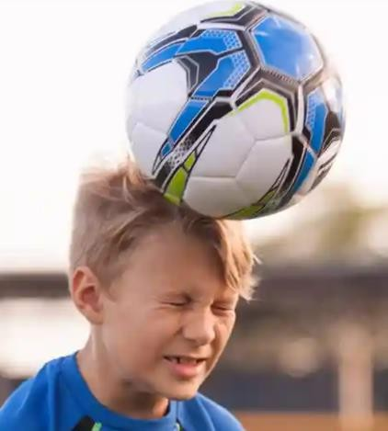
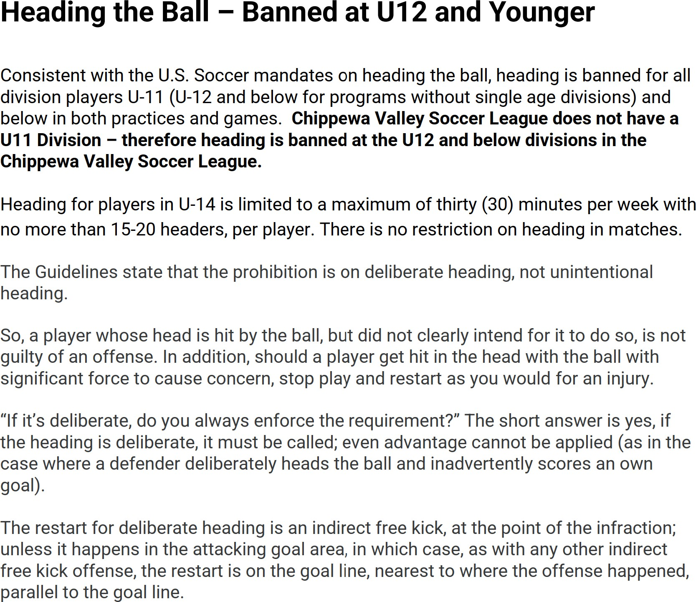

Slide 42
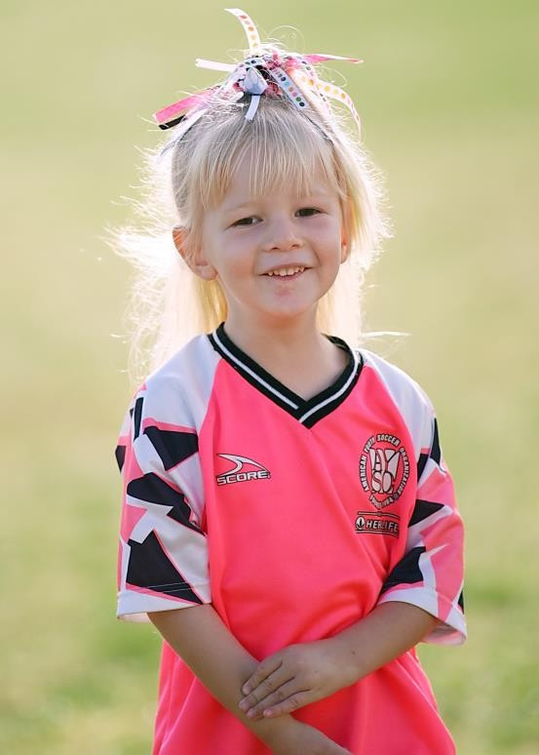
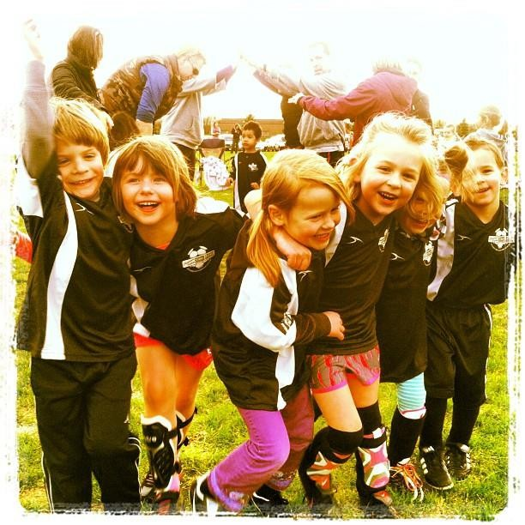
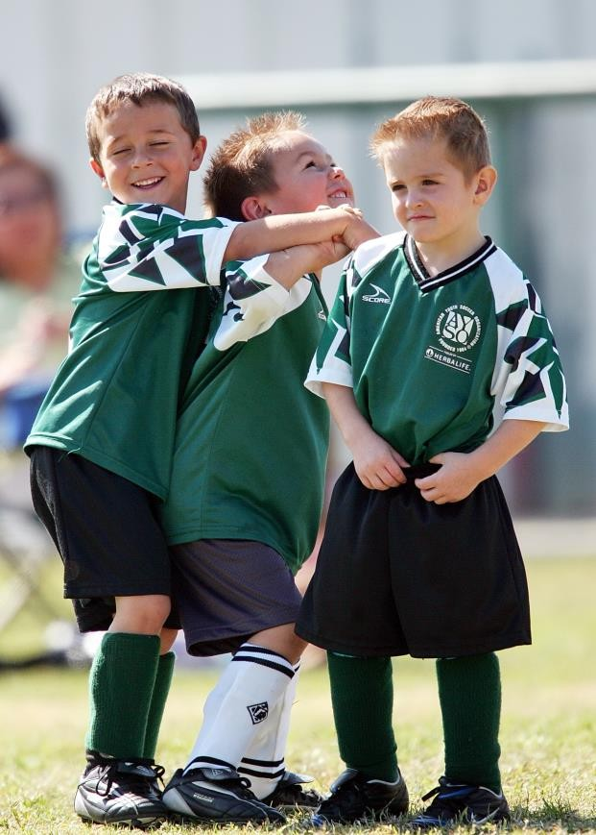
Be Positive, Make it Fun and Have Fun!!

